Slide 1
SAAJ 1.2
Topic of SOAP are
Understand SOAP standard
SAAJ API

Slide 2
so, if ourselves want to constructs and send SOAP message without above 3 type of clients, SAAJ is the API has to be used.
..
the important use of SAAJ API only in Message Handlers

Slide 3
SOAP Message
Must be if fault because of BODY
MUST Not be because of Header
Might have any arbitrary header block
Header
detail
Must be if fault because of intermediary
faultactor
Fault
faultstring
These 2 always mandatory
faultcode
Body
Sub element of “fault” can be un qulaifed.
encode
App data
RPC
document
literal

Slide 4
Document/literal
SOAP Message Mode
J2EE Not support
RPC /literal
Document/encoded
Describe the PAYLOAD of SOAP message
RPC /encoded
Message Exchange Patterns (MEP)
One -way
Request / response
Describe the FLOW of message

Slide 5
It can be used as alone or with JAX-RPC
SAAJ
By SUN
Perl::Lite
Apache SOAP
By Apache
Soap with attachment

Slide 6
SOAP with HTTP
Since, GET method does not have PAYLOAD area.
POST only
Its value the same as in WSDL
Soap over HTTP
SOAPAction
Response don’t have this header
Text/xml or multipart/ related
200
Recognized error code
415
201
400
405
500

Slide 7
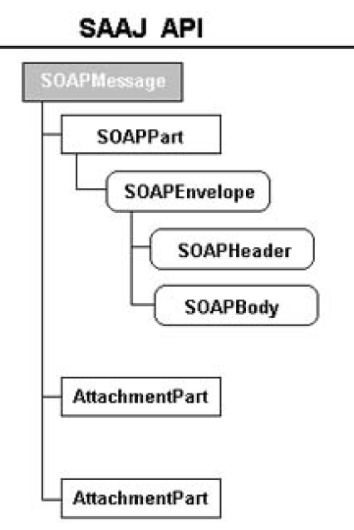
Rep. the SOAP document
Rep. the SOAP Attachment

Slide 8
Envelope
SOAPHeader
SOAP Message Structure
SOAPHeaderElement
SOAPElement
Text
SOAPBody
SOAPBodyElement
SOAPElement
Text
SOAPFault
SOAPFaultElement
Detail
DetailEntry

Slide 9
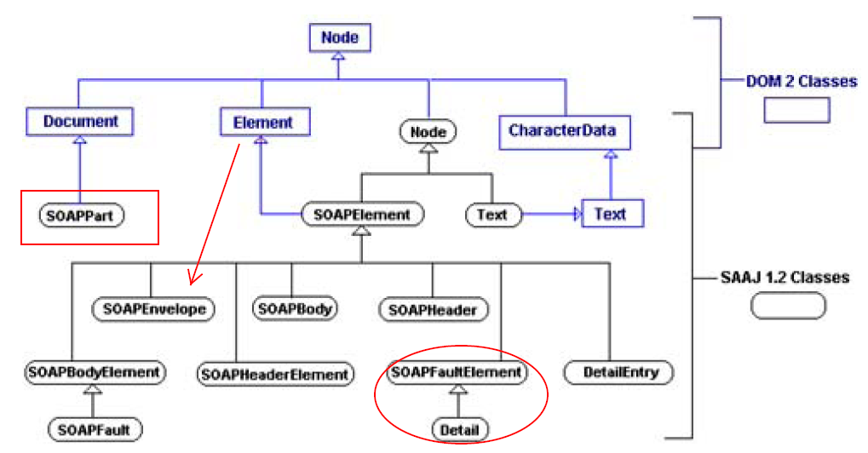
SAAJ 1.2 and DOM2 collaboration

Slide 10
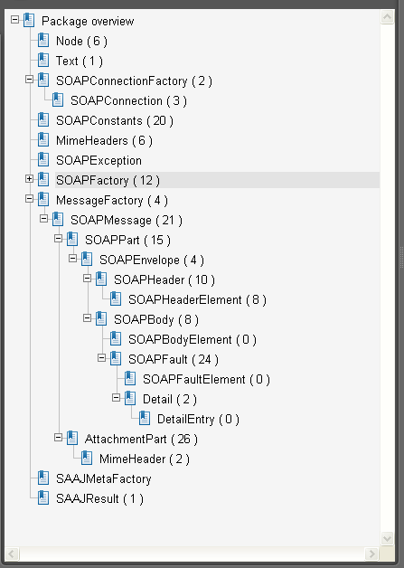
SAAJ ( SOAP ) API

Slide 11
JDK 1.6 alone is enough to evaluate SAAJ
Pre request to SOAP Message
SOAPConnectionFactory
SOAPConnection
SOAPConstant
SAAJMetaFactory
SAAJResult
SOAPElement
Node
SOAPFactory
SOAPException
Name

Slide 12
MessageFactory
Totally 26 classes / interface
SOAPMessage
Document, Node of DOM used here
SOAPPart
AttachmentPart
These two can be skipped if message don’t have attachement
MimeHeader
Content
SOAPEnvelope
It act as utility and does not relation with SOAP directly or indirectly
MimeHeaders
SOAPBody
SOAPHeader
SOAPFault
SOAPBodyElement
SOAPHeaderElement
Detail
SOAPFaultElement
Text
DetailEntry

Slide 13
SAAJ Inheritance
Node
SOAPElement
Text
SOAPEnvelope
SOAPBody
SOAPHeader
SOAPBodyElement
DetailEntry
SOAPHeaderElement
SOAPFaultElement
or
or
SOAPFault
Detail
Most PART of SOAP Message classes extend SOAPElement
Here No SOAPPart
To Run SAAJ API no need any APP server. Simply jdk 1.6 enough

